Slide 1
Discover Bourdon factory
Learning more about the people and skills behind our industry

Slide 2
Disclaimer
Title: Visite Bourdon
Author: Nicolas Birrien
E-mail: nbirrien@baumer.com
Address: Bourdon Bourdon-Haenni sas
BHFR France
www.bourdon-instruments.com
Alle Rechte an dieser Information, wie Urheber-, Patent-, Gebrauchsmuster-, Design- und/oder Markenrechte verbleiben bei der Bourdon GmbH. Kenntnis von dieser Information lässt Weiterbenutzungsrechte nicht entstehen.
All rights, especially the right to apply for and/or acquire copyright, patent, utility model, design and/or trade mark protection are reserved and remain Bourdon GmbH. Notice of this information neither constitutes nor induces any right for further use.

Slide 3
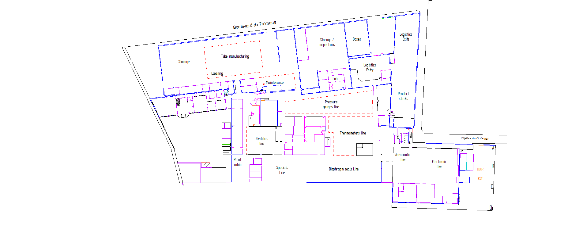
Site’s visit map.
Organizationnal
Industrial support
Manufacturing
Others
Visit Path
Meeting room
2
Job links
X
1
WEP5

Slide 4
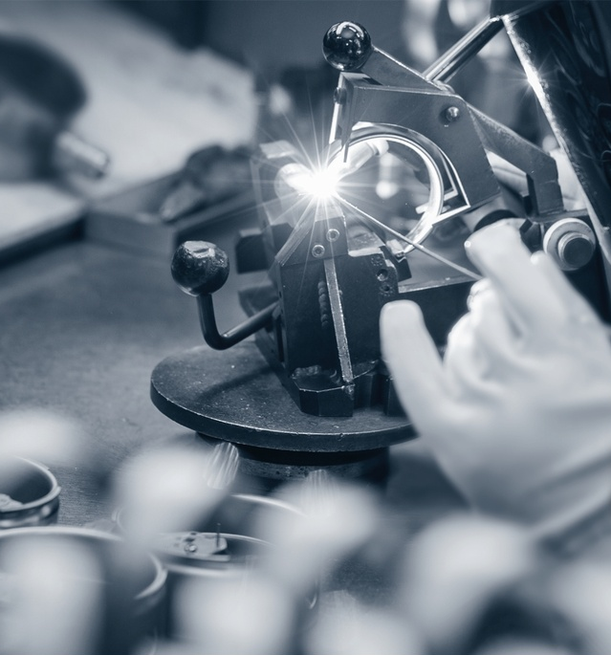
Welder
TIG weldings, our welders, and weldings are highly qualified professionnal monitored by the Welding institute. They ensure the core functionnality and quality of our products.

Slide 5
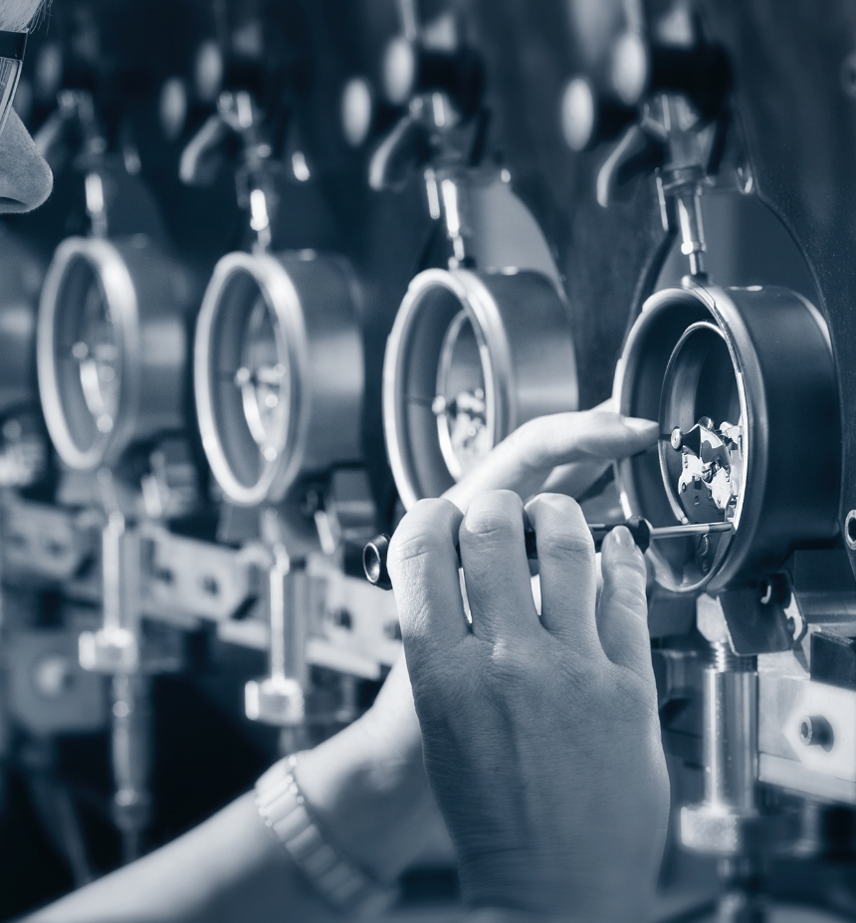
Calibration
Calibration requires training, product knowledge, patience and precision, it is the link between our Bourdon tube and the accuracy of the measure that the customer will rely on.

